Slide 1
Introduction to Computers for Engineers: Recitation #8

Slide 2
Learning Objectives
Understand and learn how the RGB color system works
Understand how RGB images are stored in MATLAB
Understand how to work with uint8 numbers in MATLAB
Use more loops!

Slide 3
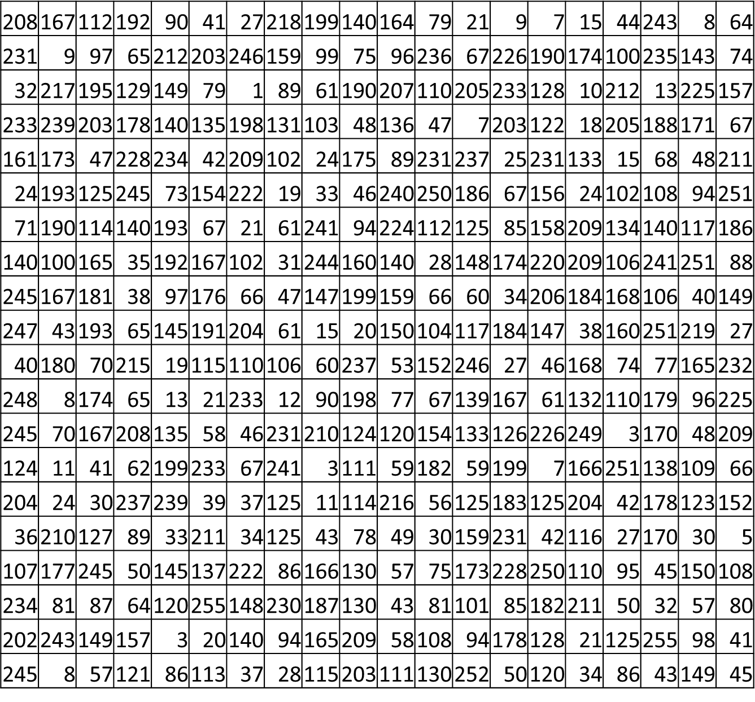
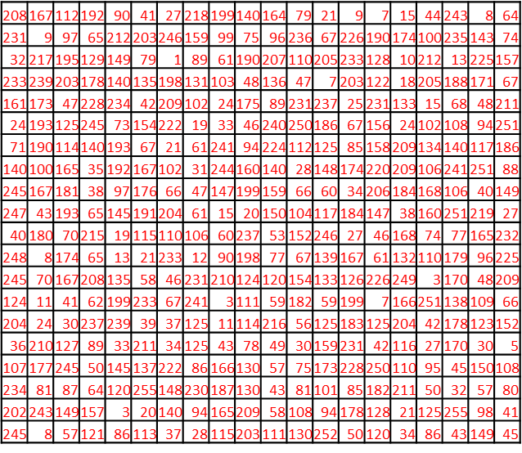
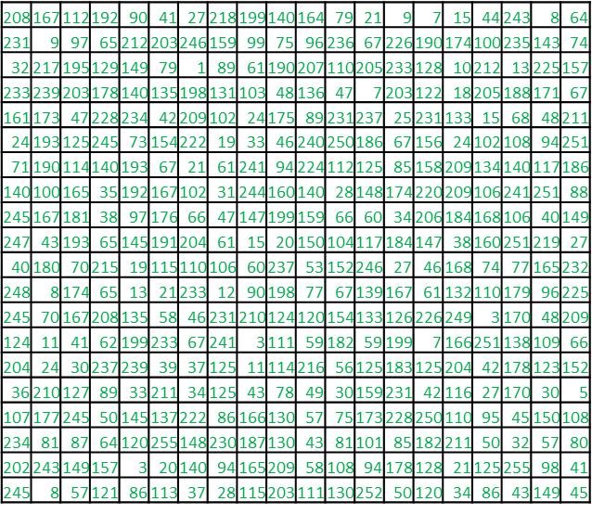
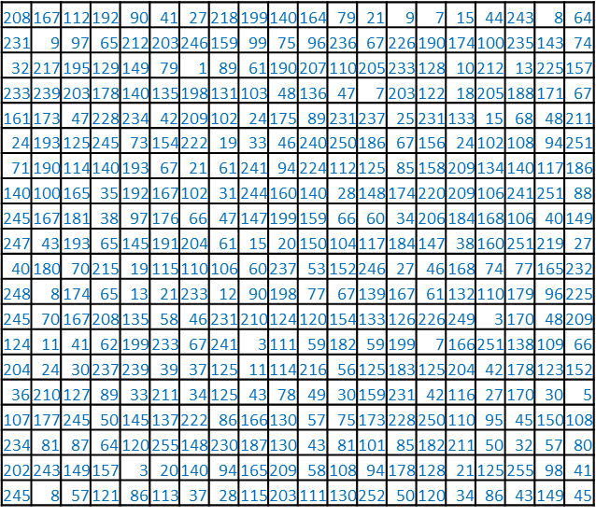
Grayscale
RGB Images
RGB

Slide 4
How do RGB images work?
RGB Images
When we store an RGB Image in MATLAB, we use a 3D array
M rows, N columns, 3 layers of color (red, green, and blue)
The shape of the array is then (m x n x 3)
This is to store the 3 individual matrices of information:
1: red
2: green
3: blue
Indexing works like this: imageVariable(rowNum, colNum, color)
Each 2D array of the RGB image take values from [0, 255]:
0 = no intensity, 255 = full intensity
For images, we want to use unsigned integers (uint8)

Slide 5
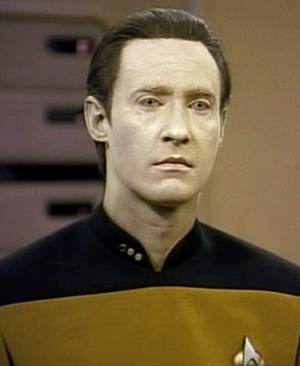
MATLAB defaults to floating point decimal numbers
Data
For example, all of these commands: zeros, ones, randn, randi, rand
Even if you place a value that was from a uint8 in a matrix, it will convert that value to floating point
You have to tell MATLAB to convert to uint8
blankImage = uint8(zeros(500,500,3));
This would create a 500x500 color image, with all of the pixels being black
All colors 0 = black
All colors 255 = white
All color values equal between 0 and 255 = a shade a of gray

Slide 6
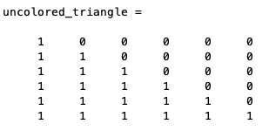
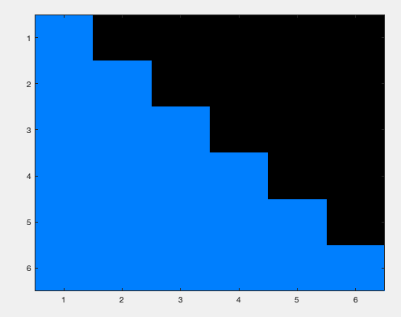
Activity 1: Playing with RGB images
Recall the activity where we made a (6x6) shape using 0s and 1s. We can make a right triangle as shown on the right.
We want to make the same triangle but with colors (also on the right).
In a script, create the triangle on the right with a (6x6x3) array. You can create those colors with the following:
R: background is 0, triangle is 0
G: background is 0, triangle is 127
B: background is 0, triangle is 254
Create this shape using a nested for-loop.
Hint: To fill in your array, keep a counter that adds 127 on each RGB loop
Turn your image into uint8 and display your image using the command image:
image(uint8(triangle))

Slide 7
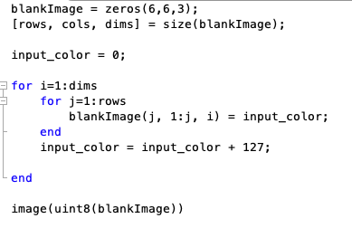
Activity 1: Solutions

Slide 8
Activity 2: The Effect of RGB
Download the image in Files/Recitation/Recitation 8/flowers.png
Read image in MATLAB using command imread
flowers = imread(‘flowers.png’)
We want to write a function in a script called colorImage that takes the following 3 inputs:
color_image: a 3D array
readColor: a double (1, 2, 3)
writeColor: a double (1, 2, 3)
The purpose of this function is to take the color information from readColor, and assign it to the color location of writeColor
The values in the layer of readColor should remain unchanged
The values in the layer of writeColor should change to match those in readColor
The output should be color_image but with the changes as described above
Use imshow to display your results
imshow(imageVariable)

Slide 9
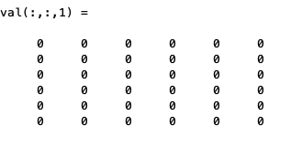
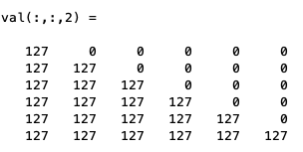
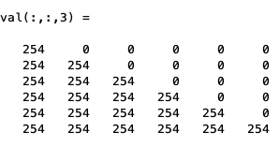
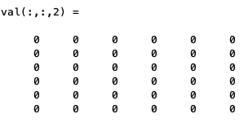
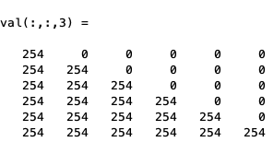
Activity 2: The Effect of RGB (Example)

Slide 10
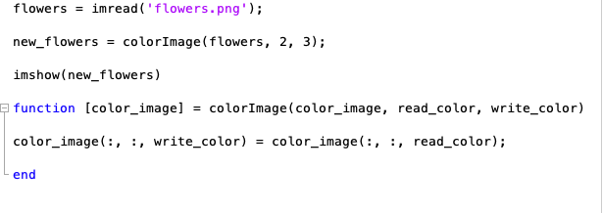

Activity 2: Solution

Slide 11
Activity 3: Stretching arrays
Write a function called imageStretch that takes 1 input:
input_image: 3D array with dimensions (m, n, 3)
The purpose of this function is to manipulate your input image by stretching it row-wise, such that the result is an image with 2*m rows.
Output_image: 3D array with dimensions (2m, n, 3)
Procedure:
Find the number of rows and number of columns of your image
Initialize output with 2*m rows, n columns, 3 layers of color
Use a nested for-loop to place values from the original image in every other row of the blank image, starting with row 1 for all RGB channels
Go through the even rows of your new image and place what you placed for the odd number
Hint: You can input the odd rows by 2*i-1 and evens by 2*i, where i is the index

Slide 12
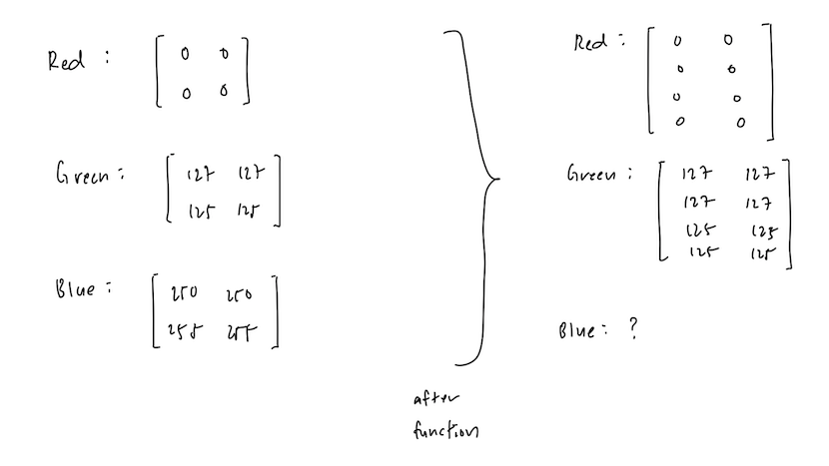
Activity 3: Stretching arrays (Example)

Slide 13
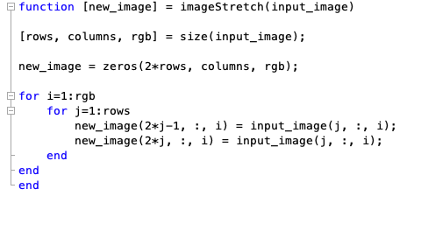
Activity 3: Solution

